Slide 1
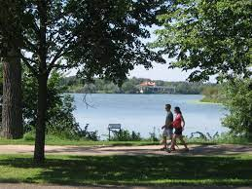
Walkability across Minnesota
Group 4
Hampton Hughes
Sunita Kumari
Tanner Victorian
Daniel Lee
Abdulrahman Issa

Slide 2
How is Walkability Measured?
“Walkability is characterized by components of the built environment that influence the likelihood or feasibility of walking as a form of utilitarian transportation”
National Walkability Index inputs:
Intersection density (33%) - Higher intersection density is correlated with more walk trips.
Proximity to transit stops (33%) - Distance from population center to nearest transit stop in meters. Shorter distances correlate with more walk trips.
Land Diversity (33%):
Employment Mix - The mix of employment types in a block group (such as retail, office, or industrial).
Housing and Employment Mix - The mix of employment types and occupied housing. A block group with a diverse set of employment types (such as office, retail, and service) plus many occupied housing units will have a relatively high value.
Source: Environmental Protection Agency (Smart Location Database)
https://www.epa.gov/smartgrowth/national-walkability-index-user-guide-and-methodology

Slide 3
How is Walkability sorted into groups?
Walkability Index Scores
“Block Groups (BGs) are statistical divisions of census tracts, are generally defined to contain between 600 and 3,000 people, and are used to present data and control block numbering.”
“The block groups are assigned their final National Walkability Index scores on a scale of 1 to 20. The scores are categorized as follows:
1 – 5.75 Least walkable
5.76 – 10.5 Below average walkable
10.51 – 15.25 Above average walkable
15.26 – 20 Most walkable”

Slide 4
What you’ll discover
Walkability amongst block and counties within Minnesota as a whole -Tanner
Impact of walkability on
Physical activity -Hampton
Housing populations - Daniel
Cars per household - Issa
Wage Stratification - Sunita

Slide 5
Minnesota Walkability % by Block Groups
Tanner

Slide 6
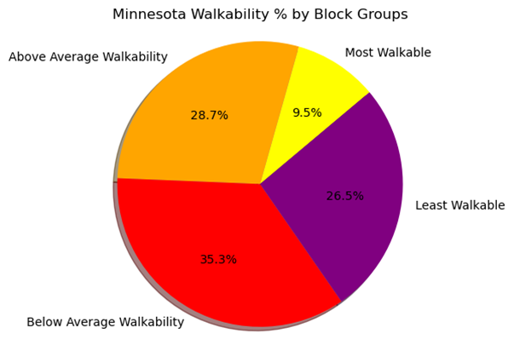
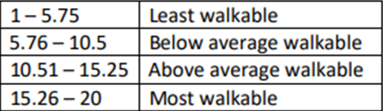
Minnesota Walkability % by Block Groups Walkability % by Block Walkability % by Block Groups
Looking at the National Walkability Index scores, 61.8% of Minnesota falls between 1-10.5. This shows us that Minnesota, as a whole, is not a very walkable state.

Slide 7
Which Counties have the highest and lowest walkability in Minnesota?
Tanner

Slide 8
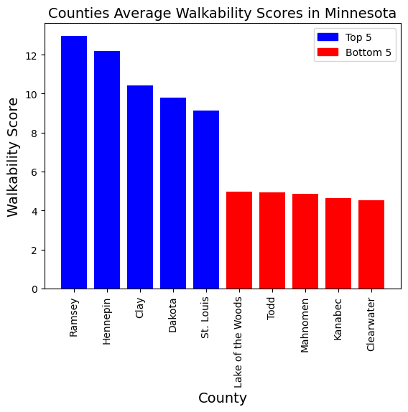
Which Counties have the highest and lowest walkability in Minnesota?
Top 5 counties: Ramsey, Hennepin, Clay, Dakota, St.Louis
Bottom 5 counties: LOTW, Todd, mahnomen, Kanabec, Clearwater
This information can be helpful when looking at a state and seeing what counties would be easier to get around via walking vs counties that may require some other form of transportation.

Slide 9
What is the impact of walkability on physical and mental health?

Slide 10
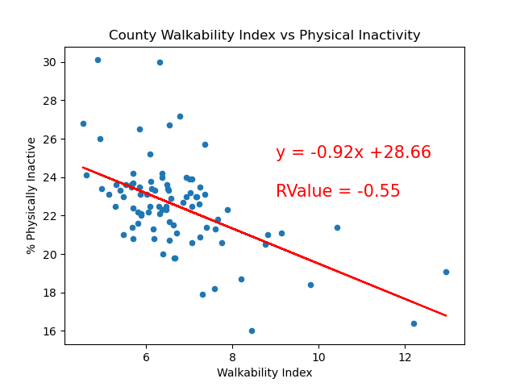
Impact of Walkability on Physical Activity (by county)
There is a moderate negative correlation (rvalue = -.55) between walkability and adult physical activity*
As the average walkability score across MN counties increases, the percentage of adults reporting no physical activity decreases
Walkability has a positive impact of physical activity!
Source: Smart Location Database, US County Health Rankings
*Percentage of adults age 18 and over reporting no leisure-time or physical activity

Slide 11
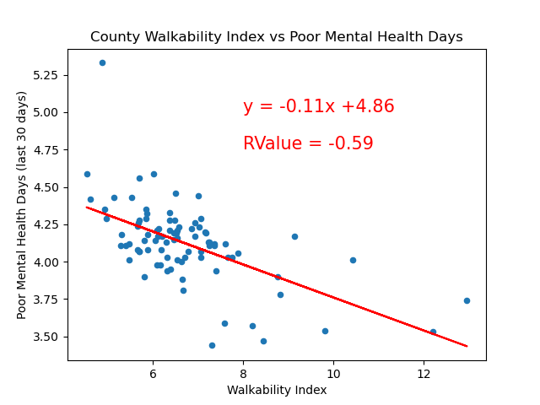
Impact of Walkability on Mental Health (by county)
There is a moderate negative correlation (rvalue = -.59) between walkability and mental health.
As the average walkability score across MN counties increases, the average number of poor mental health days* decreases.
Walkable neighborhoods boost mental health!
Source: Smart Location Database, US County Health Rankings
*Average number of mentally unhealthy days reported in past 30 days

Slide 12
Residential and Population Density impact on Walkability - Dan

Slide 13
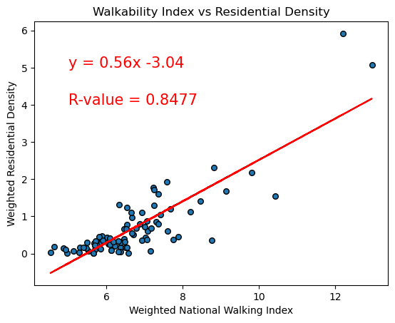
Residential Density vs Walkability
There is a very strong positive correlation between residential density and walkability of counties

Slide 14
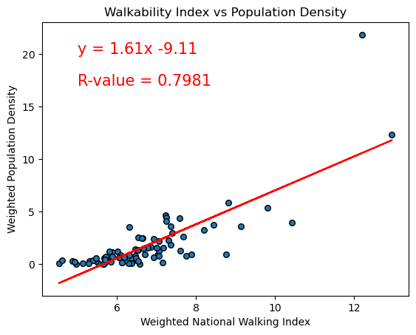
Population Density vs Walkability
There is a strong positive correlation between population density and walkability of counties

Slide 15
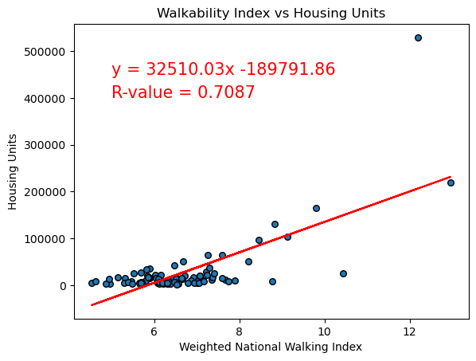
Housing Units vs Walkability
Total housing units in a county have a strong positive correlation with walkability

Slide 16
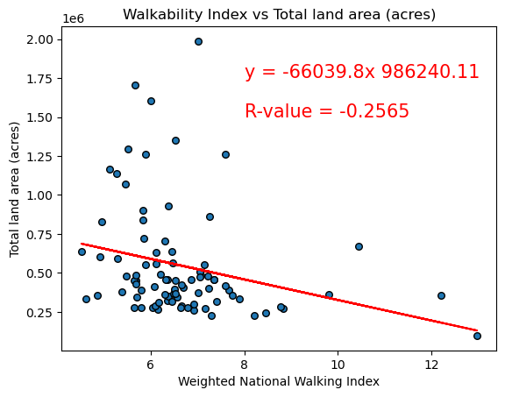
Total land area (acres) vs Walkability
When excluding ‘St. Louis County’, a higher total land area results in a weak negative correlation between total land and walkability
With ‘St Louis County’ included, the r-value drops to -0.0385
Notes:
St Louis County is anything north of Duluth to the border

Slide 17
Density impacts Walkability
Both higher Population and Residential density have a strong positive impact on the walkability of a county
However, while total amount of housing units in a county has a strong positive impact on walkability, total land area (acres) has a weak negative to no correlation with walkability
In conclusion, more people and housing results in better walkability, but surprisingly a larger county does not factor into walkability

Slide 18
Number of Cars per Household Impact on Walkability

Slide 19
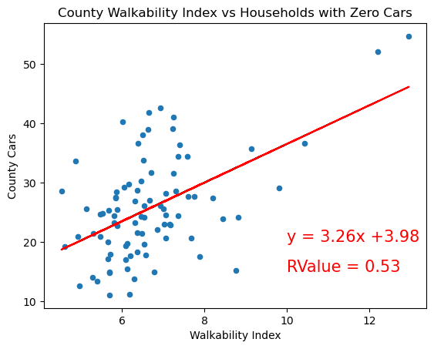
Zero Car Households vs Walkability
There is a moderate positive correlation between households with zero cars and walkability.

Slide 20
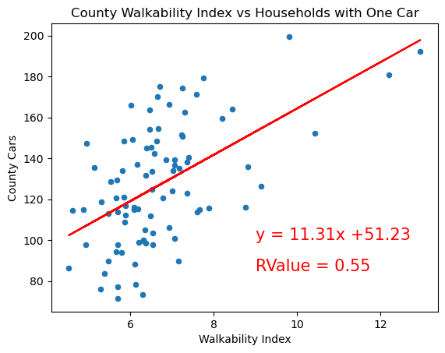
One Car Households vs Walkability
There is a moderate positive correlation between households with zero cars and walkability.

Slide 21
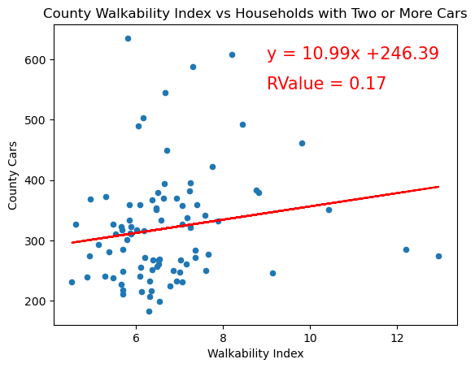
Two or More Car Households vs Walkability
There is a very weak positive correlation between households with two or more cars and walkability.
A significant decrease in R-Value from households with zero or one car.

Slide 22
Association Between Wage Stratification and Walkability

Slide 23
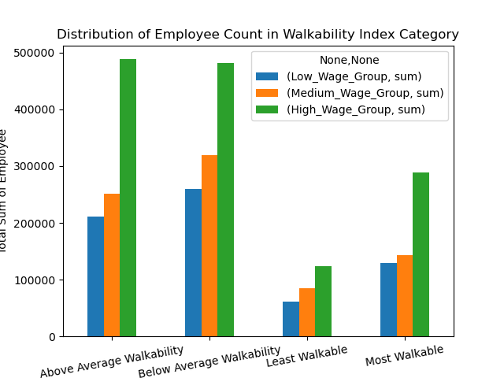
Employee Count in Each Walkability Index Category
Wage Group Classification
(Wage Stratification based on workplace location)
Low Wage Group: Earnings equal or less than $1250 /month
Medium Wage Group: Earnings between $1250 and $3333 /month
High Wage Group: Earnings Above $3333 /month
Datasource: USEPA

Slide 24
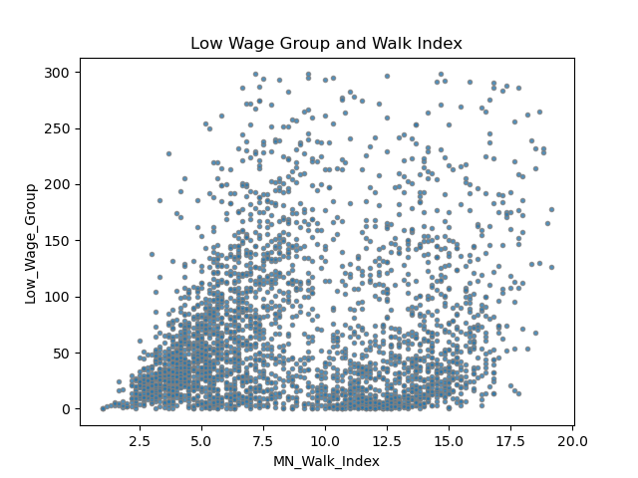
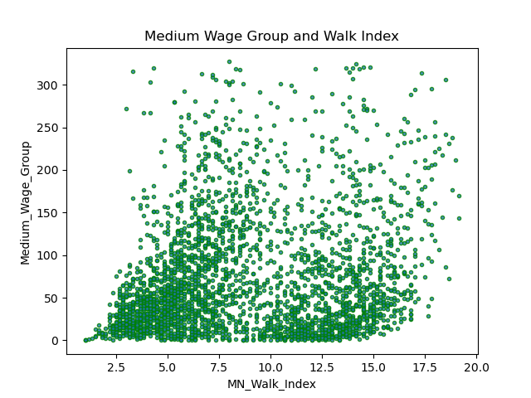
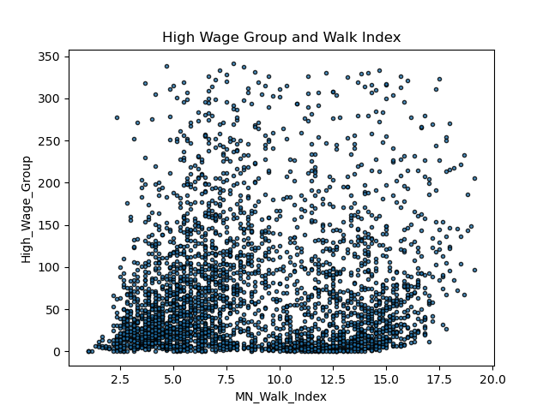
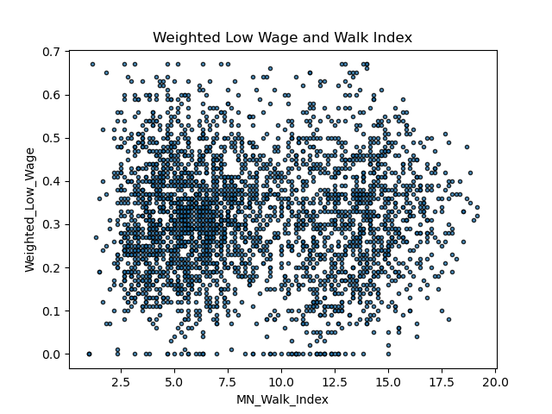
Plot between the Wage Group in Walk-Index
-Data was cleaned for any outliers
Plot display the wide spread in the data set

Slide 25
CORRELATION MATRIX (Pearson) | Census Block group | Low Wage Group | Medium Wage Group | High Wage Group | Weighted Low Wage | MN Walk Index
Census Blockgroup | 1.000
Low Wage Group | 0.036 | 1.000
Medium Wage Group | 0.027 | 0.842 | 1.000
High Wage Group | 0.046 | 0.613 | 0.730 | 1.000
Weighted Low Wage | 0.015 | 0.299 | -0.020 | -0.281 | 1.000
MN Walk ndex | -0.089 | 0.190 | 0.183 | 0.119 | -0.002 | 1.000

Slide 26
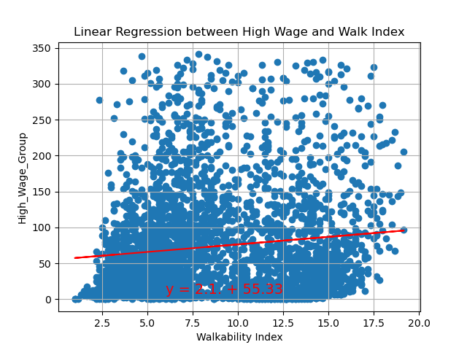
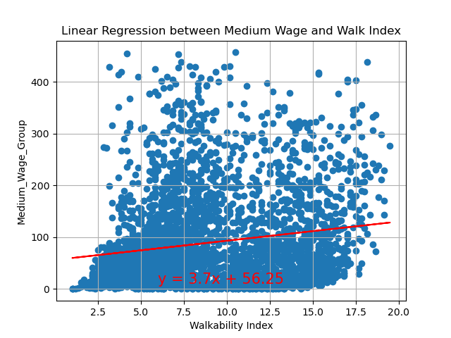
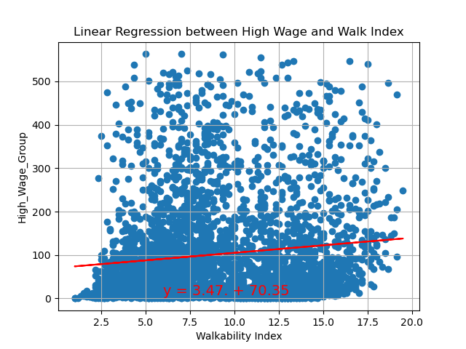
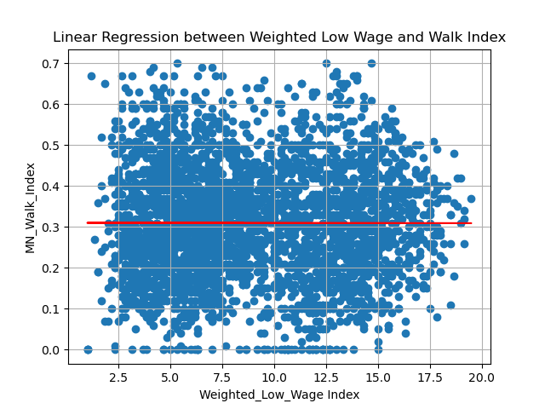
Linear Regression
There was very low association established between the Walkability Index and the Wage Groups.
None of the Wage Group Employees had a very strong correlation with the walkability Index. However, the association established was positive.
Linear Regression was able to explain 3% of variation in Walkability Index.
Regression line equation is: y = 3.83x + 46.57
R squared: 0.039
Regression line equation is: y = 3.7x + 56.25
R squared: 0.030
Regression line equation is: y = 3.47. + 70.35
R squared: 0.015
Regression line equation is: y = -0.0x + 0.31
R squared: 2.376

Slide 27
Appendix
www.census.gov/programs-surveys/geography/guidance
https://www.countyhealthrankings.org/
https://www.epa.gov/sites/default/files/2021-06/documents/epa_sld_3.0_technicaldocumentationuserguide_may2021.pdf
https://www.epa.gov/sites/default/files/2021-06/documents/national_walkability_index_methodology_and_user_guide_june2021.pdf
https://www.census.gov/programs-surveys/geography/about/glossary.html#par_textimage_4
https://catalog.data.gov/dataset/walkability-index

Slide 28
Methodology
We used the total population per County to give a weight to each datapoint
Weight = Data point Population / County Population
We then used this number to apply to the walkability index when aggregating all data points at the county level to determine a county’s walkability as well as for other columns that used averages

